Slide 1
Timing Specification in Little-JIL
Wenzhe Wu

Slide 2
Outline
Introduction
Background
Timing specification in Little-JIL
Summary
Further Work

Slide 3
Introduction
Motivation:
The timing of behavior is
an important aspect of process definitions
often critical for the correctness of overall processes
Goals:
Provide the capability for modeling timing requirements in Little-JIL
Support reasoning about these timing requirements

Slide 4
Outline
Introduction
Background
Little-JIL language
Timing requirement
Existing timing specification in Little-JIL
Timing specification in Little-JIL
Summary
Further Work

Slide 5
Little-JIL Language
Little-JIL
is a graphic language for modeling processes
represents a unit of work as a step, and has well defined events that indicate when a step enters one of its states:
posted
started
terminated
completed

Slide 6
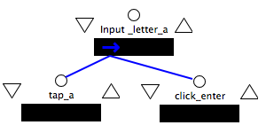
Timing Requirement
Time Requirements: on the timed sequence of events that a process is allowed to perform
Example:
For the above “input_letter_a” process, timing requirements could be:
“click_enter” must occur more than 0.1 seconds after “tap_a” occurs
“tap_a” must be finished in 0.1 seconds from when it’s started

Slide 7
Existing Timing Specification in Little-JIL
Deadline Timers
specify maximum durations on step executions
are defined only at leaf steps
if timer expires before step execution is done, Little-JIL system will throw an exception
Dynamic Scheduling as proposed by A. Cass
try to ensure that steps will be completed within specified deadlines
allows for not scheduling some tasks while still scheduling the time-critical tasks(dynamic, not focus on what I am going to do)
takes both timing estimates and resource requirements into account
Notes:
Estimate on interval steps

Slide 8
Problems
Not expressive enough to represent needed timing requirements in processes
E.g. “click_enter” must occur more than 0.1 seconds after “tap_a” occurs
Lack of support for static analysis
I am going to focus on the first two problems in this project, --- timing specifications

Slide 9
Outline
Introduction
Background
Timing specification in Little-JIL
Extension of timing specification
Types of timing specification
Path Notation
Syntax
Issues to address
Summary
Further Work

Slide 10
Extension of current Timing Specifications
An event in Little-JIL is a step entering one of its states
A timing requirement is a constraint about the duration between the occurrences of any two events

Slide 11
Types of Timing Specification
Delay: duration must be longer than a certain amount of time
delay from event A to B means that B must wait for some time to occur after A occurs
Deadline: duration must be shorter than a certain amount of time
deadline from event A to B means that B must occur shortly enough after A occurs
a part of deadline is already supported in Little-JIL

Slide 12
Path Notation syntax
Since timing requirements are defined between any two events, path notation is used for locating the steps in which these events occur.
Path notation in Little-JIL is based on XPath
/ : immediate children
if it is the first one, it means the root
can neglect the first “/” if selecting from the root step
// : all descendants
. : current step
.. : parent of current step

Slide 13
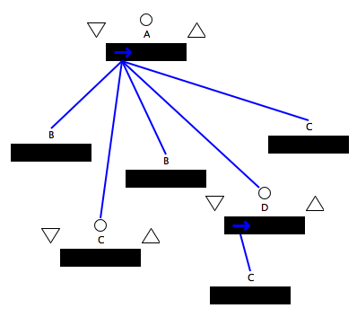
Path Notation in Little-JIL
/- the root step
/B – all B steps which are children of root step
A/D/C – all C steps which are children of D which are children of root A
AAA//C– all C steps in the process under root A
Note that path notation may return a collection of steps
Notes:
Single instances vs. multiple instances second and third examples are same!!! Define animation
Collections need to say… don’t allow collection interpreted the collection different ways really high light issues!!! Say!!!

Slide 14
Path Notation in Little-JIL
/- the root step
/B – all B steps which are children of root step
A/D/C – all C steps which are children of D which are children of root A
AAA//C– all C steps in the process under root A
Note that path notation may return a collection of steps
Notes:
Single instances vs. multiple instances second and third examples are same!!! Define animation
Collections need to say… don’t allow collection interpreted the collection different ways really high light issues!!! Say!!!

Slide 15
Path Notation in Little-JIL
/- the root step
/B – all B steps which are children of root step
A/D/C – all C steps which are children of D which are children of root A
A//C– all C steps in the process are descendants of root A
Note that path notation may return a collection of steps
Notes:
Single instances vs. multiple instances second and third examples are same!!! Define animation
Collections need to say… don’t allow collection interpreted the collection different ways really high light issues!!! Say!!!

Slide 16
Path Notation in Little-JIL
/- the root step
/B – all B steps which are children of root step
A/D/C – all C steps which are children of D which are children of root A
AAA//C– all C steps in the process under root A
Note that path notation may return a collection of steps
Notes:
Single instances vs. multiple instances second and third examples are same!!! Define animation
Collections need to say… don’t allow collection interpreted the collection different ways really high light issues!!! Say!!!
C is not need to be leaf steps

Slide 17
Path Notation in Little-JIL
To locate a single step from a collection:
A/B[1] – the first substep B of root A
A/B[last()] – the last substep B of root A
A//C[2] – the second descendant C of A(DFS search)
Notes:
Conjuctions b[3] the second A/[2] sandy!!

Slide 18
Path Notation in Little-JIL
To locate a single step from a collection:
A/B[1] – the first substep B of root A
A/B[last()] – the last substep B of root A
A//C[2] – the second descendant C of A(DFS search)
Notes:
conjuctions

Slide 19
Path Notation in Little-JIL
To locate a single step from a collection:
A/B[1] – the first substep B of root A
A/B[last()] – the last substep B of root A
A//C[2] – the second descendant C of A(DFS search)
Notes:
Conjuctions DFS deal with exceptions preconditions and post conditions

Slide 20
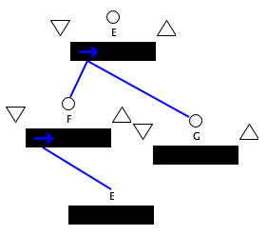
Relative Path Notation
Unroll the process:
E1
F1
G1
E2
F2
G2
For all i,
Gi has to start within 10 time units after Fi completes
E3
Time requirement:
Step G has to start within 10 time units after step F completes
G3
F3
… …
Notes:
Every iteration, something’s may happen

Slide 21
Relative Path Notation cont.
Number of occurrences of a step may be infinite!
With always searching from the root, it can’t express above requirement unless unrolling the process with a given scope
Introduce aliases
“.” to refer the current step instance
“..” to refer the parent step of current step instance
For step Fi,
.. is Ei, parent of current instance Fi
../G is Gi, the sibling instance of current instance Fi
Notes:
Troubles instance

Slide 22
Syntax
StartStep:state -> EndStep:state[Delay, Deadline]
Notes:
Syntax on exceptions, preconditions and post conditons

Slide 23
Issues to Address
executable semantics for timing specifications
exceptions
timers checking
single step vs. collection of steps
Notes:
Cycle completes soon enough
Cycle in littlt-jil from a start to a start
Period of a loop!!! Could it be a loop?

Slide 24
Executable Semantics for Timing Specifications
Two types of exceptions can be thrown
EventTooEarly -- violation of delay constraint
EventTooLate -- violation of deadline constraint
EventTooEarly
EventTooLate
timeline
delay
deadline
Notes:
limit

Slide 25
Executable Semantics for Timing Specifications
An intuitive implementation
Initialize two timers when StartStep entering its specified state, for delay and deadline respectively
When EndStep entering into its specified state, check the delay timers, throw EventTooEarly if the lower bound is not reached yet
If the deadline timer expires before the EndStep enters its specified state, throw EventTooLate
Timed exceptions are handled in the same way as other exceptions are handled in Little-JIL

Slide 26
Single Step vs. Collection of Steps
Path notation in Little-JIL may return
a single step instance (using relative path) e.g. for F ../G returns only sibling instance G of current instance F
a single step type e.g. /E/G returns step type G
a collection of steps e.g. /E/ returns both immediate children of E, F and G
Notes:
Static vs. dynamic

Slide 27
Single Step vs. Collection of Steps
Different ways to interpret it:
disallow returning more than one step instance
allow returning multiple step instances
Only take care of the first occurrence of those instances
Only take care of the last occurrence of those instances
Take care of the first occurrence for deadline constraints while the last one for delay constraints
Specified by users (need to modify the syntax)
Need to figure out which interpretation is better in most of the cases

Slide 28
Single Step vs. Collection of Steps
Disallow multiple instances
Pros
a TC (time requirement) is precisely a constraint between two instances
users can do conjunction or disjunction on several events
Cons
users need to carefully write the TC to ensure TC return one instance
TC set for one step may be big
Allow multiple instances
Pros
reduce the size of TC set for one step
use of path notation is more flexible
Is a more natural way if there are several references with same step name existed in process
Cons
bad interpretation will bring more problems

Slide 29
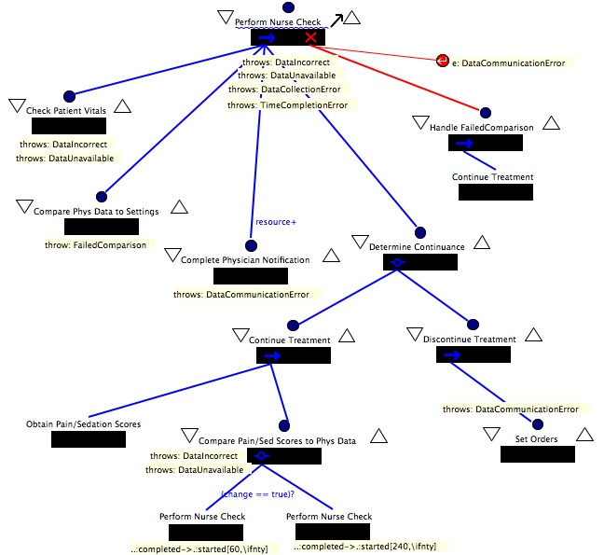
Example – infusion process

Slide 30
Example - infusion process
Timing requirements description:
After infusion therapy starts, the nurse should perform several rounds of checks on patient. At the end of each round of checks, the nurse compares the Pain/Sedation scores with Patient’s physical data to determine when to do the next round.
If (change == true), the nurse should wait at least 60 time units before performing another check. If(change == false), the nurse should wait at least 240 time units.

Slide 31
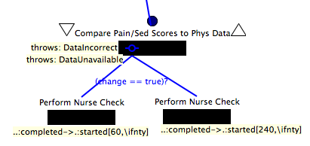
Example – infusion process

Slide 32
Example - problem
After specifying the timing requirements, we find that the requirement can’t be satisfied because “compare pain/sed score to phys data” is parent of “perform nurse check” thus can’t be completed until its children are completed
It turns out that the process definition should be modified

Slide 33
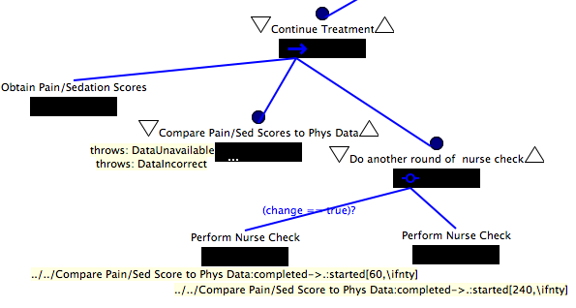
Example – modified infusion process

Slide 34
Outline
Introduction
Background
Timing specification in Little-JIL
Summary
Further Work

Slide 35
Summary
Proposed timing specification has the capability of presenting types of timing requirements
an approach that will allow the ﬂexible specification of real-time requirements in a variety of scenarios
Notes:
Some issues we address
Impact of rewriting the little-jil

Slide 36
Outline
Introduction
Background
Timing specification in Little-JIL
Summary
Further Work

Slide 37
Further Work
1. extend the path notation in little-jil with relative paths
2. implement the UI support for specifying the proposed time requirements
Rewrite little-jil
3. seek for an algorithm to transfer little-jil processes to networks of timed automata
4. support the dynamic execution semantics

